Slide 1
Photovoltaic Cell Modelling and Simulation
Submission 1 : Individual Paper Presentation
Name : | Mirza Ahmad Shayer
ID : | 22273008
Course : | Petri Net Theory And Modeling Of Systems
Faculty : | Annajiat Alim Rasel [AAR]

Slide 2
In our modern world, many renewable forms of energy are required to combat the loss of our primary non-renewable resources. This is where photovoltaic cells or solar panels come in. The ability to turn solar energy into usable electricity is essentially needed to have a greener future.
However, to design such wonders requires powerful simulation and modelling tools to see how they will function, how efficiently they can be designed and how ergonomic the designs can be.
For this specific purpose, we need photovoltaic cell modelling and simulation.

Slide 3
Here, the paper related to the topic is given below.
The paper - Modelling, Validation, and Simulation of Solar Photovoltaic Modules by Alhassan Ali Teyabeen & Ali Elseddig Jwaid – 2023
Paper link - https://electricajournal.org/Content/files/sayilar/94/48-60.pdf
This paper states that the output electricity depends on the input variables of solar radiation and temperature. Therefore understanding how much the variables affect the output is very important.

Slide 4
In the paper the modelling of solar PV modules based on double-diode model equivalent circuit was achieved using MATLAB script by estimating parameters of the non-linear I-V curve using Newton-Raphson method by adjusting the non-linear I-V curve at three points: maximum power, open circuit voltage, and short circuit current.
The model was later validated by comparing its predicted performance with measured data of KYOCERA KC125GT solar PV module recorded at the field. Root mean square error, RMSE, and correlation coefficient, R2 were used to see statistical errors. The simulation results show that the increase in solar radiation will result in an increase in harvested power, and the increase in temperature will result in a decrease in harvested power.

Slide 5
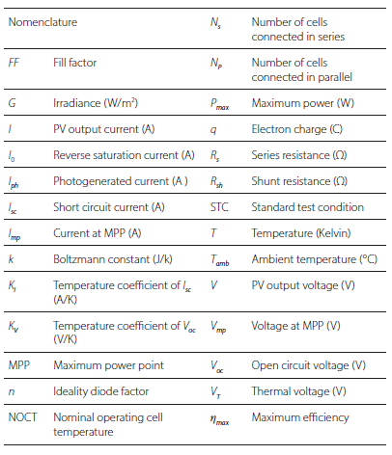
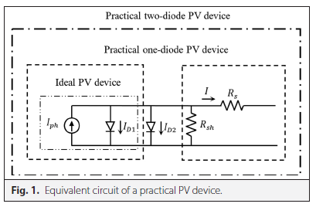
The simulations, models, results of the experiments are shown below.

Slide 6
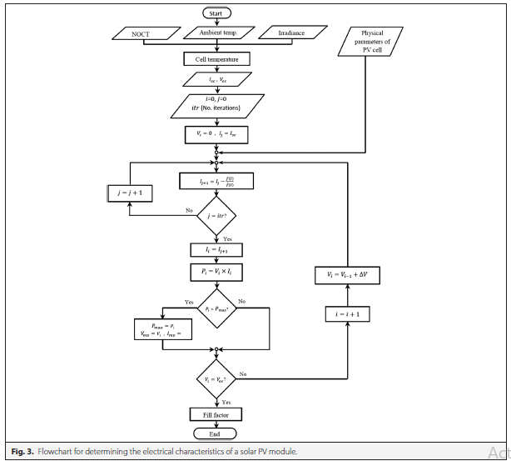
The model flow chart

Slide 7
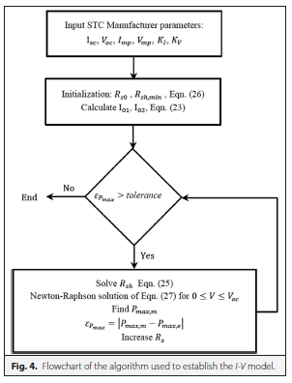
The validation flowchart

Slide 8



Equations of PV devices
A. Ideal Solar PV Cell
B. Single-Diode Mathematical Model
Iph- photogenerated current
ID- diode current
I0 - reverse saturation current,
e - exponential function,
n - diode ideality factor (ideal value is 1)
V - terminal voltage
VT - thermal voltage
Rs - a series resistance
Rsh - a shunt resistance
T temperature
k Boltzmann constant (1.38064 × 10−23 J/K)
q electron charge 1.6021 × 10−19 C

Slide 9






Equations of PV devices - continued
C. Double-Diode Mathematical Model
Iph - photogenerated current,
I01, I02 - saturation currents of diode D1, D2 respectively.
N1, N2 - ideality factor of diode D1, D2, respectively.
Isc module short circuit current
Rs module series resistance
Rsh module shunt resistance.
Isc,STC, Voc,STC short circuit current, open circuit voltage at standard test condition (STC) respectively.
KI, KV temperature coefficients of short circuit current, open circuit voltage respectively
ΔT difference between the actual and STC temperature
Tamb ambient temperature
NOCT usually informed in the datasheet
G is the irradiation (in W/m2).

Slide 10






Components of IV curve
A. Short Circuit Current
G, GSTC actual irradiance on the surface of module
and the irradiance at standard test condition, respectively
B. Open Circuit Voltage
C. Maximum Power Point
D. Fill Factor
The temperature coefficient KV of the open circuit voltage is informed in the datasheet
E. Efficiency of the Solar PV Module
ηmax maximum efficiency

Slide 11


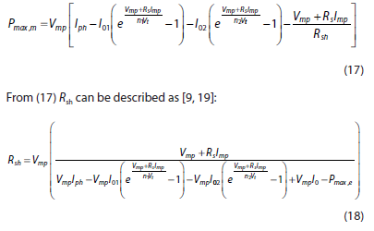

Parameters estimation of solar PV module Equations
Ii ith iteration current
f(I) is derivative of the form f(I)

Slide 12
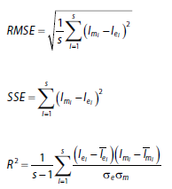
Model Validation Equations
Imi, Iei - ith current values of the mathematical model and the experiment respectively
Imi, Iei - mean values of the established current of I-V curve and the experimental current respectively
σm, σe - standard deviation of the established current of I-V curve and the experimental current respectively
s number of samples.

Slide 13
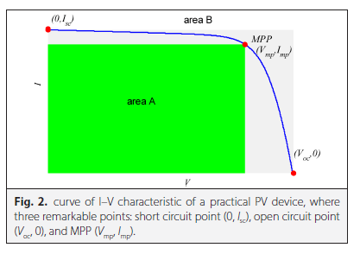
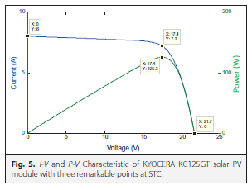
Results of the experiments
Characteristic Graphs

Slide 14
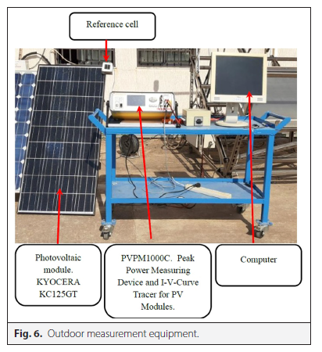
Equipment

Slide 15
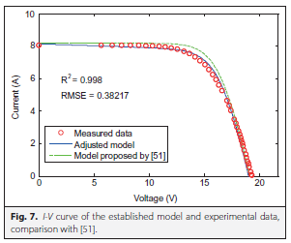
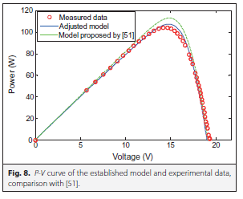
Model and experimental data comparison graphs

Slide 16
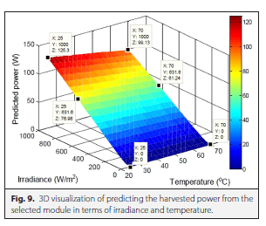
3D Visualization

Slide 17
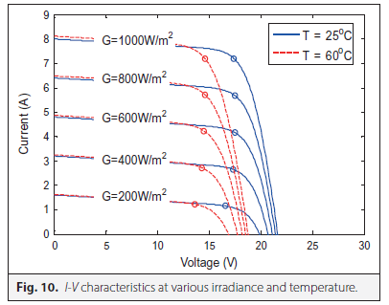
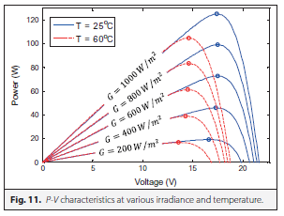
Characteristics at various irradiance and temperature

Slide 18
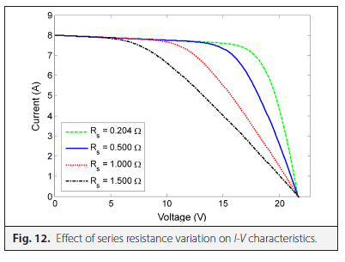
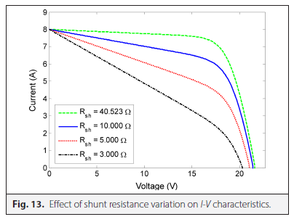
Resistance variation on I-V characteristics

Slide 19
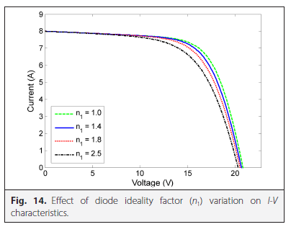
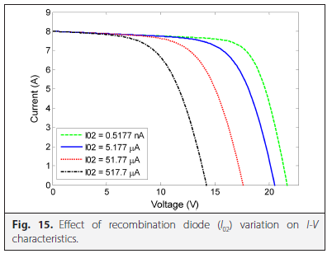
Effect of diode ideality factor and recombination diode

Slide 20
Conclusion
In this paper a mathematical model was established based on double diode equivalent circuit to describe the performance of solar PV module, also to predict the performance under different weather conditions.
The model parameters were estimated using the numerical Newton-Raphson method. Measured data of KYOCERA KC125GT solar PV panel (module) recorded at the field were used to validate the established model. The accuracy of the established model is evaluated using statistical error tests such as correlation coefficient, absolute error, and root mean square error.

Slide 21
It can be concluded that:
The effect of irradiance is strong on short circuit current, and the effect of temperature is strong on the open circuit voltage.
The short circuit current depends strongly on solar irradiance. The higher the irradiance the larger the short circuit current, which in turn the larger the harvested power, whereas, the open circuit voltage is not going to vary much.
The increase in temperature decreases the open circuit voltage, and the maximum output power degrades accordingly. whereas, the short circuit current almost remains constant.
The most parameter affected by series and shunt resistances is the fill factor, and consequently the output power. The fill factor decreases at increasing series resistance and decreasing shunt resistance.
The increase in reverse saturation current of the second diode decreases the open circuit voltage heavily, and consequently the output maximum power.

Slide 22
Thank you.
Any Questions?

